Slide 1
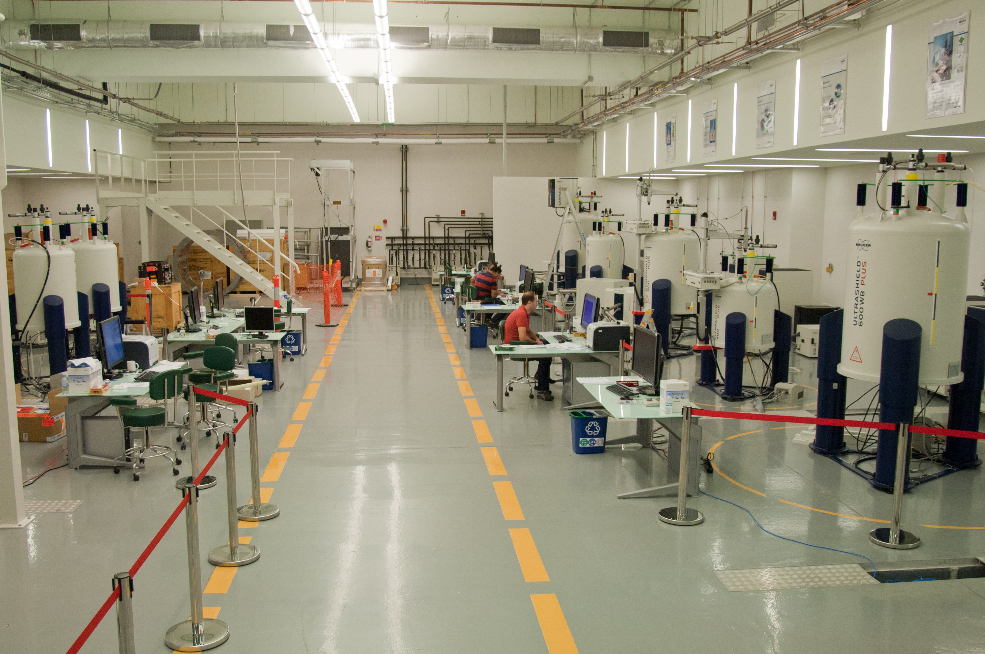
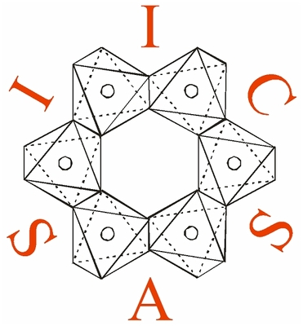
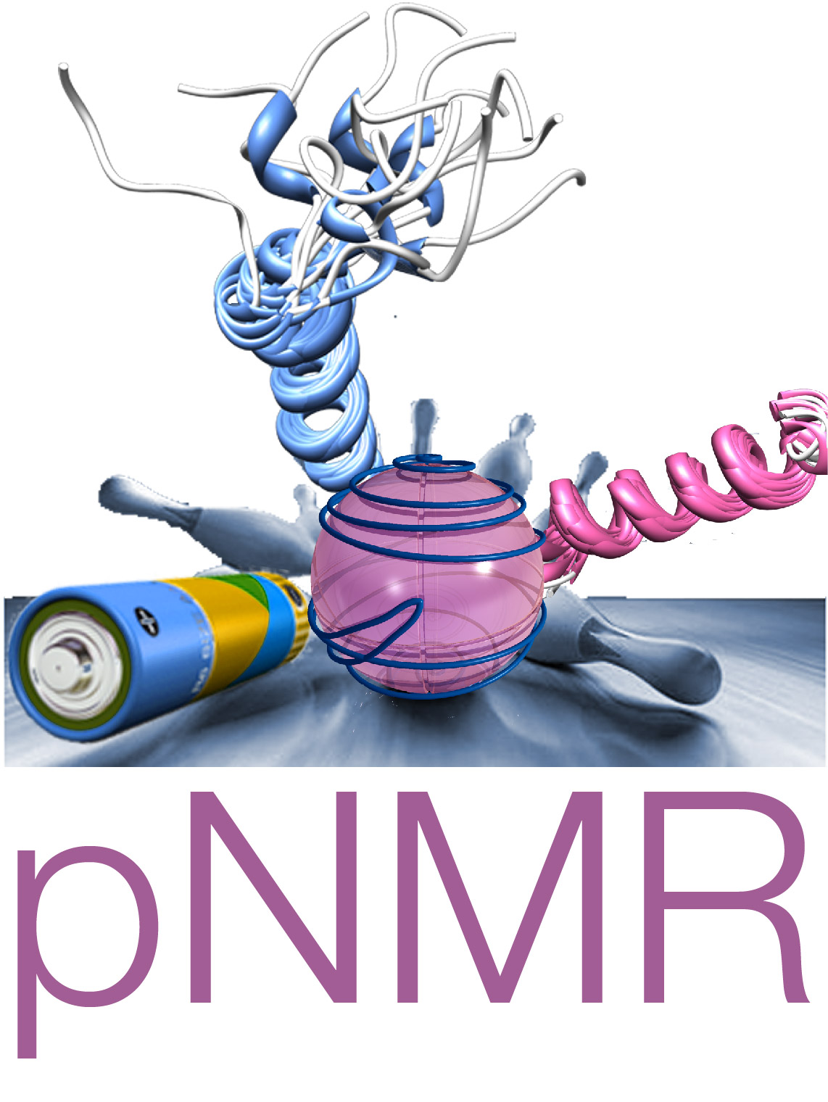
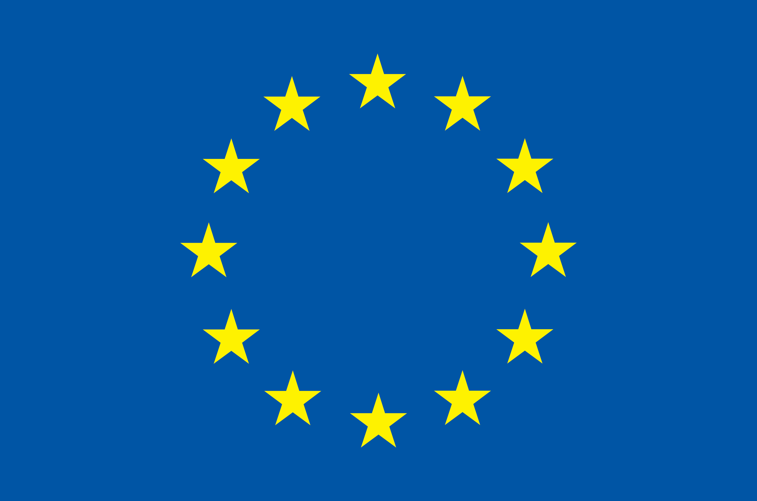
Computational modelling of magnetic resonance experiments
Peter Cherry

Slide 2
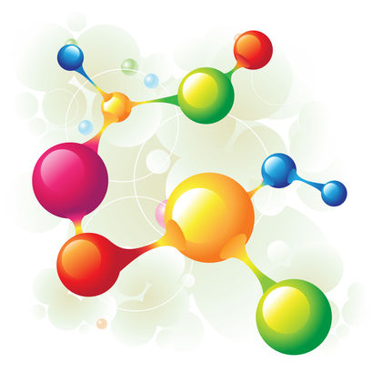
Topics
1) Nuclear spin-spin coupling in paramagnetic systems.
2) Obtaining g-tensors from unrestricted determinants.
3) G-tensor theory for strong spin-orbit coupling.

Slide 3
Topics
1) Nuclear spin-spin coupling in paramagnetic systems.
2) Obtaining g-tensors from unrestricted determinants.
3) G-tensor theory for strong spin-orbit coupling.

Slide 4
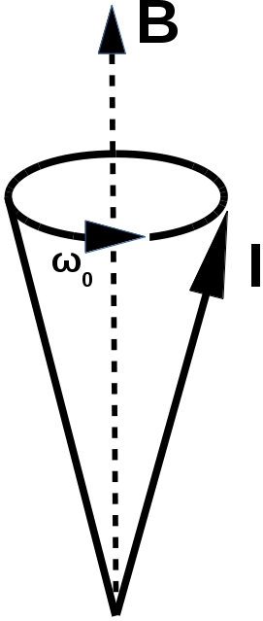
Nuclear Magnetic Resonance (NMR)
Characterize system based on its response to an external magnetic field.
Nuclear spins will precess about the magnetic field.
This is the Larmor precession, it is what experiments measure.
The frequency of the Larmor precession influenced by
1) Nuclear isotope.
2) Electron-nuclear interactions.
3) Nuclear-nuclear interactions.
4) And many others....
Fig. 1: Larmor precession cone.
Fig 2: Nucleon.

Slide 5
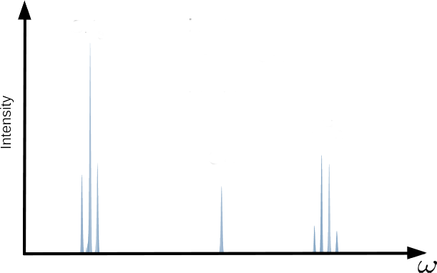
J-coupling
CH₃
H
H
Fig. 3 : 90 MHz Proton NMR spectra for ethyl alcohol in CDCl₃ .Data retrieved from spectral database for organic compounds[2].
H
C
C
O
H
H
H
CH₂
OH
[2] http://sdbs.db.aist.go.jp/sdbs/cgi-bin/direct_frame_disp.cgi?sdbsno=13

Slide 6
J-coupling
Interaction is mediated by electron charge density:
Nuclear spin-spin interaction is mediated by the currents which the nuclear moments induce in the electron density.
e⁻
e⁻
e⁻
e⁻
e⁻
e⁻
e⁻
e⁻
e⁻
e⁻
e⁻
e⁻
e⁻
e⁻

Slide 7
Paramagnetic spin-spin coupling enhancement
Measurement of nuclear spin-spin coupling is central to many NMR techniques.
Theory of nuclear spin-spin coupling was developed for diamagnetic systems.

Slide 8
Paramagnetic spin-spin coupling enhancement
Measurement of nuclear spin-spin coupling is central to many NMR techniques.
Theory of nuclear spin-spin coupling was developed for diamagnetic systems.
Q1) Is J-coupling qualitatively different in systems with unpaired electrons?

Slide 9
Paramagnetic spin-spin coupling enhancement
Measurement of nuclear spin-spin coupling is central to many NMR techniques.
Theory of nuclear spin-spin coupling was developed for diamagnetic systems.
Q1) Is J-coupling qualitatively different in systems with unpaired electrons?
Q2) Do we need to account for it when analyzing pNMR spectra?

Slide 10
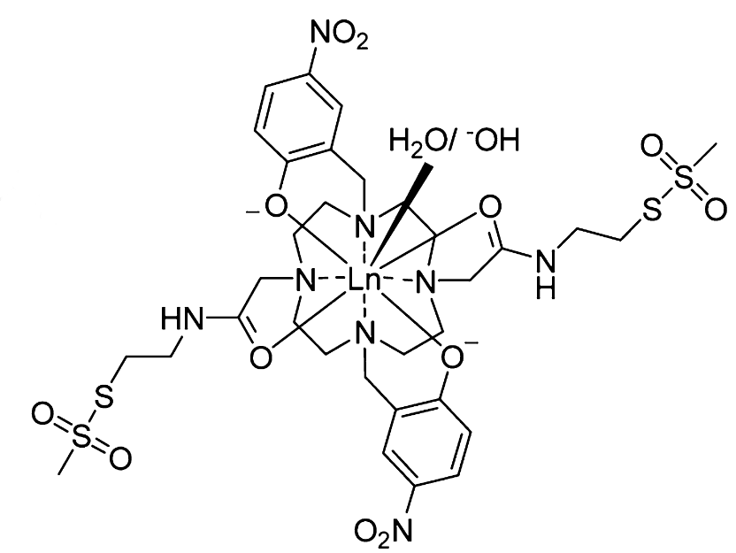
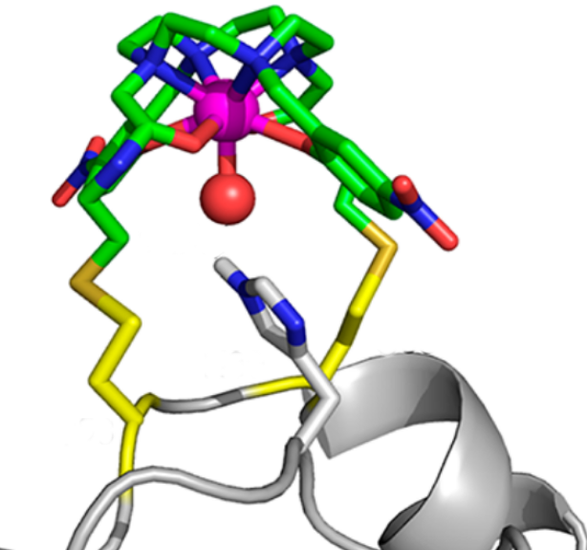
Structure Determination with pNMR
Use paramagnetic tags to make molecules artifically paramagnetic.
Compare spectra for tagged and untagged molecules.
(a)
W.-M. Liu, P. H. Keizers, M. A. Hass, A. Blok, M. Timmer, A. J. Sarris, M. Overhand, and M. Ubbink, JACS, 41 (2012).
(b)
Fig.4 (a) Lewis structure of CLaNP-7 parmagnetic tag (b) CLaNP-7 binding to protein.

Slide 11
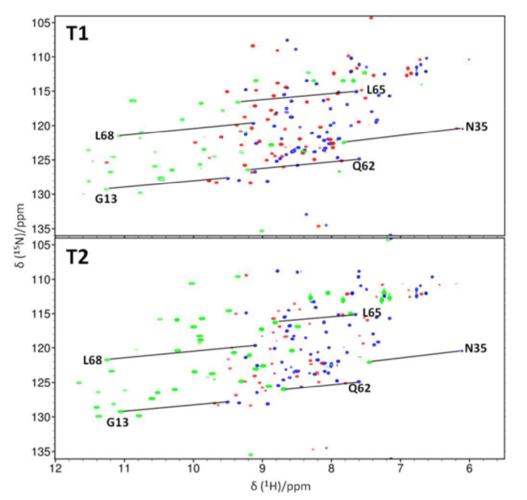
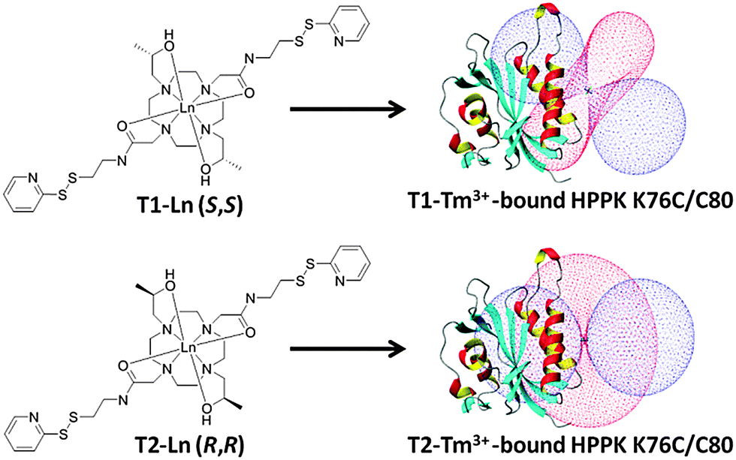
Paramagnetic shifts in NMR spectra
M. Lee, M. Dennis, J. Swarbrick, and B. Graham, Chem. Comm., 52, (2016).
(a)
(a)
(b)
(b)
Fig. 5 (a) & (b) 2D spectra corresponding to tags in Fig. 6 (a) & (b).
Fig. 6 (a) & (b) Protein with para-magnetic tag bound in two different positions.

Slide 12
Paramagnetic shifts in NMR spectra
M. Lee, M. Dennis, J. Swarbrick, and B. Graham, Chem. Comm., 52, (2016).
Two main effects:
Pseudocontact shift (PCS): Coupling of nucleus with electron spin-density.
Residual Dipolar Coupling (RDC): more complicated.
(a)
(b)
Fig. 5 (a) & (b) Protein with para-magnetic tag bound in two different positions.

Slide 13
Paramagnetic shifts in NMR spectra
M. Lee, M. Dennis, J. Swarbrick, and B. Graham, Chem. Comm., 52, (2016).
Two main effects:
Pseudocontact shift (PCS): Coupling of nucleus with electron spin-density.
Residual Dipolar Coupling (RDC): more complicated.
New effect:
Paramagnetic J-coupling enhancement.
(a)
(b)
Fig. 5 (a) & (b) Protein with para-magnetic tag bound in two different positions.

Slide 14
Pseudocontact shift
Interaction of nuclear moment with electron spin density.
Unique to paramagnetic systems; it is only possible when there are unpaired electrons.

Slide 15
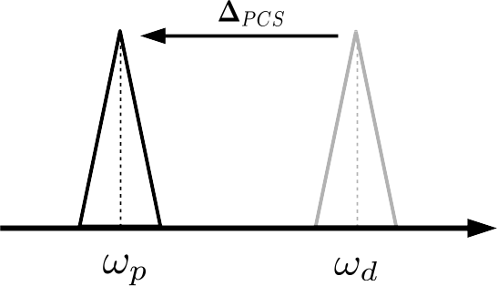
Pseudocontact shift
Pseudocontact shift moves peaks in the NMR spectra

Slide 16
Residual dipolar coupling
The spins of different nuclei can interact via dipolar coupling:
Interaction given by:

Slide 17
Residual dipolar coupling
The spins of different nuclei can interact via dipolar coupling:
Averaging over all directions causes this term to vanish.
Due to anisotropy caused by paramagnetic tag this term does not vanish.

Slide 18
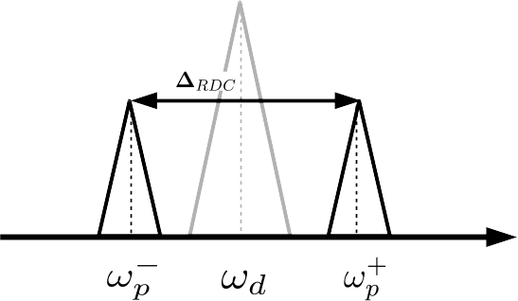
Residual dipolar coupling
Residual dipolar coupling splits peaks in the pNMR spectra

Slide 19
Residual dipolar coupling
Residual dipolar coupling splits peaks in the pNMR spectra
Could there be increased splitting due to a paramagnetic enhancement of J-coupling?

Slide 20
J-coupling
Interaction is mediated by electron charge density:
In diamagnetic systems there are no unpaired electrons.
Nuclear spin-spin interaction is mediated by the currents which the nuclear moments induce in the electron density.
e⁻
e⁻
e⁻
e⁻
e⁻
e⁻
e⁻
e⁻
e⁻
e⁻
e⁻
e⁻
e⁻
e⁻

Slide 21
J-coupling enhancement
Interaction is mediated by electron spin density:
Paramagnetic systems have unparied electrons and the nuclear spins can interact via the electron spins.

Slide 22
Paramagnetic J-coupling enhancement
New contribution to spectra: Paramagnetic enhancement of J-coupling.
J. Autschbach, J.Annu. Rep. Comput. Chem. (2015).
P. J. Cherry, S. A. Rouf, and J. Vaara, JCTC, in press (2017)

Slide 23
Hyperfine terms
New contribution to spectra: Paramagnetic enhancement of J-coupling.
The hyperfine interaction couples nuclear spins to the electron spin density.
J. Autschbach, J.Annu. Rep. Comput. Chem. (2015).
P. J. Cherry, S. A. Rouf, and J. Vaara, JCTC, in press (2017)

Slide 24
SS dyadic
New contribution to spectra: Paramagnetic enhancement of J-coupling.
The hyperfine interaction couples nuclear spins to the electron spin density.
Spin density then “transmits” interaction of nuclear spins.
J. Autschbach, J.Annu. Rep. Comput. Chem. (2015).
P. J. Cherry, S. A. Rouf, and J. Vaara, JCTC, in press (2017)

Slide 25
Paramagnetic J-coupling enhancement
New contribution to spectra: Paramagnetic enhancement of J-coupling.
The hyperfine interaction couples nuclear spins to the electron spin density.
Spin density then “transmits” interaction of nuclear spins.
No dependence on distance between nuclei!
J. Autschbach, J.Annu. Rep. Comput. Chem. (2015).
P. J. Cherry, S. A. Rouf, and J. Vaara, JCTC, in press (2017)

Slide 26
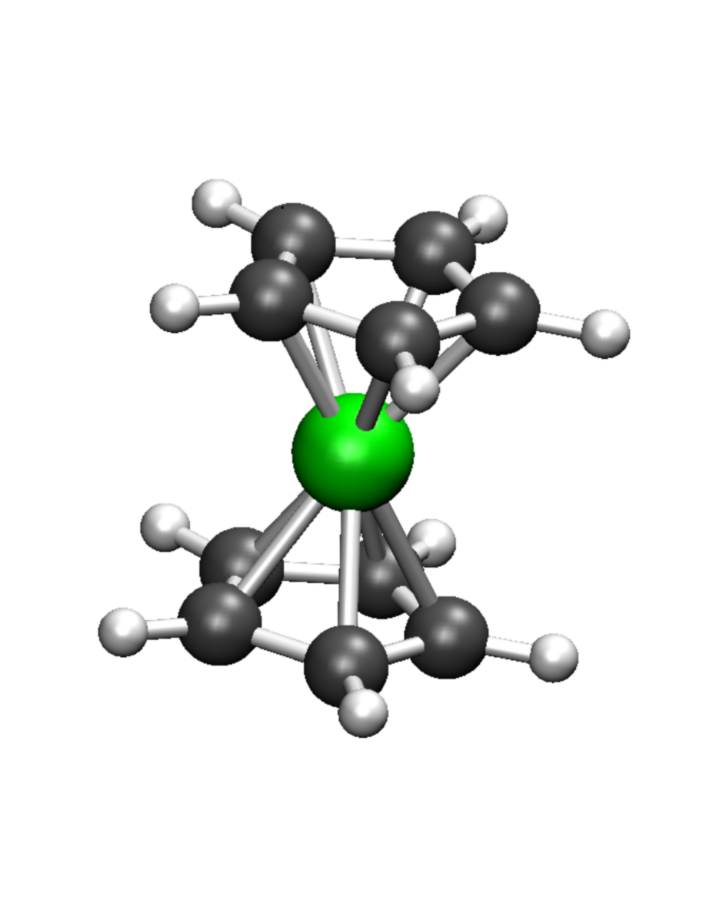
Test Systems: Metallocenes

Slide 27
Test Systems: Metallocenes
Fe
Ferrocene:
Diamagnetic.
No unpaired electrons.
No J enhancement.

Slide 28
Test Systems: Metallocenes
Fe
Cr
Ni
Ferrocene:
Diamagnetic.
No unpaired electrons.
No J enhancement.
Chromocene:
Paramagnetic.
Three unpaired electrons.
J enhancement.
Nickelocene:
Paramagnetic.
Three unpaired electrons.
J enhancement.

Slide 29
J-coupling Notation
Number of bonds seperating nuclei
³J_{HH}
Coupled nuclei

Slide 30
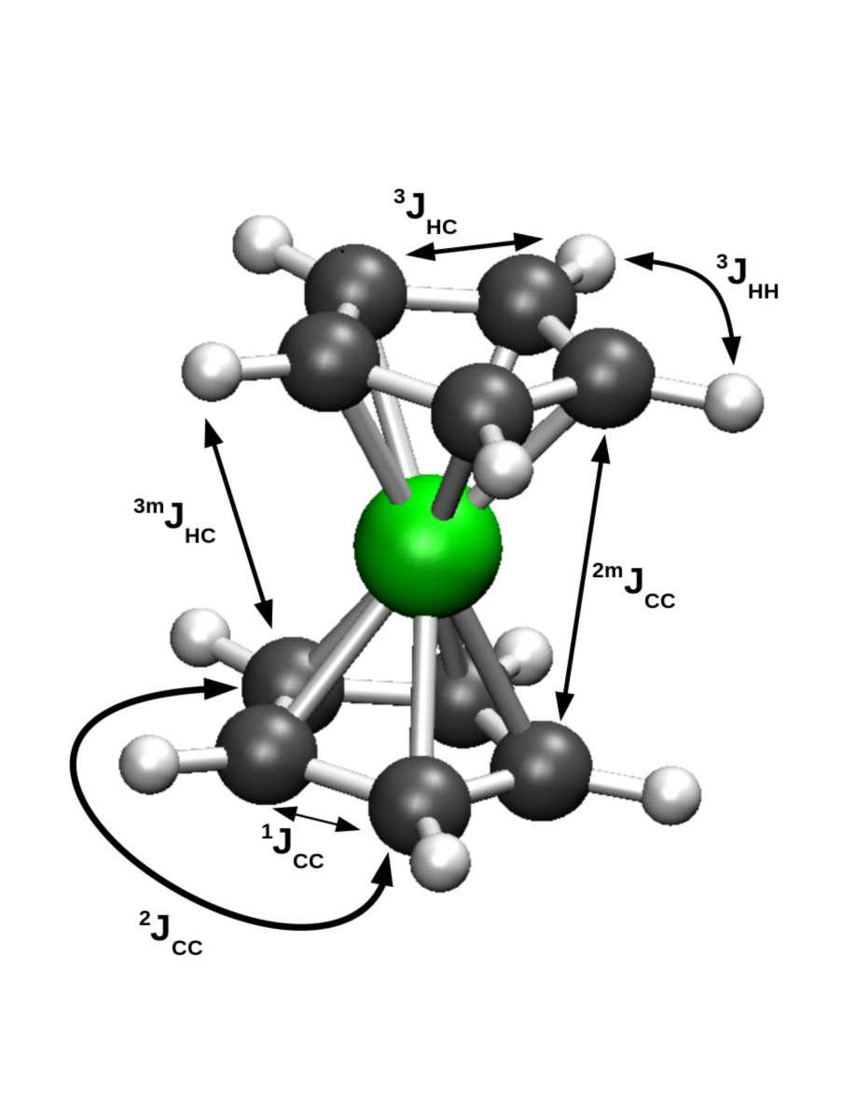
J-enhancement in metallocenes
 | J(Hz) | Enhancement (Hz)
 | FeCp₂ | NiCp₂ | CrCp₂
 | (m=1) | (m=4) | (m=4)
³J_{HH}
¹J_{CC}
¹J_{CH}
^{4m}J_{HH}
^{2m}J_{CC}
^{3m}J_{CH}
Table 1: Comparison between unenhanced isotropic J-values for ferrocene, and the corresponding enhancement in nickelocene and chromocene.
Fig. 8: Metallocene structure. Hydrogens
→ white. Carbons → grey. Metal → green.

Slide 31
J-enhancement in metallocenes
 | J(Hz) | Enhancement (Hz)
 | FeCp₂ | NiCp₂ | CrCp₂
 | (m=1) | (m=4) | (m=4)
³J_{HH} | 8.0 | 0.65 | 1.50
¹J_{CC} | 88.5 | 5.42 | -0.02
¹J_{CH} | 172.9 | -1.17 | -0.04
^{4m}J_{HH}
^{2m}J_{CC}
^{3m}J_{CH}
Same
Ring
Table 1: Comparison between unenhanced isotropic J-values for ferrocene, and the corresponding enhancement in nickelocene and chromocene.
Fig. 8: Metallocene structure. Hydrogens
→ white. Carbons → grey. Metal → green.

Slide 32
J-enhancement in metallocenes
 | J(Hz) | Enhancement (Hz)
 | FeCp₂ | NiCp₂ | CrCp₂
 | (m=1) | (m=4) | (m=4)
³J_{HH} | 8.0 | 0.65 | 1.50
¹J_{CC} | 88.5 | 5.42 | -0.02
¹J_{CH} | 172.9 | -1.17 | -0.04
^{4m}J_{HH} | 0.0 | 1.24 | 1.79
^{2m}J_{CC} | -0.3 | 5.66 | 0.11
^{3m}J_{CH} | 0.0 | -1.66 | -0.48
Different
Ring
Table 1: Comparison between unenhanced isotropic J-values for ferrocene, and the corresponding enhancement in nickelocene and chromocene.
Fig. 8: Metallocene structure. Hydrogens
→ white. Carbons → grey. Metal → green.

Slide 33
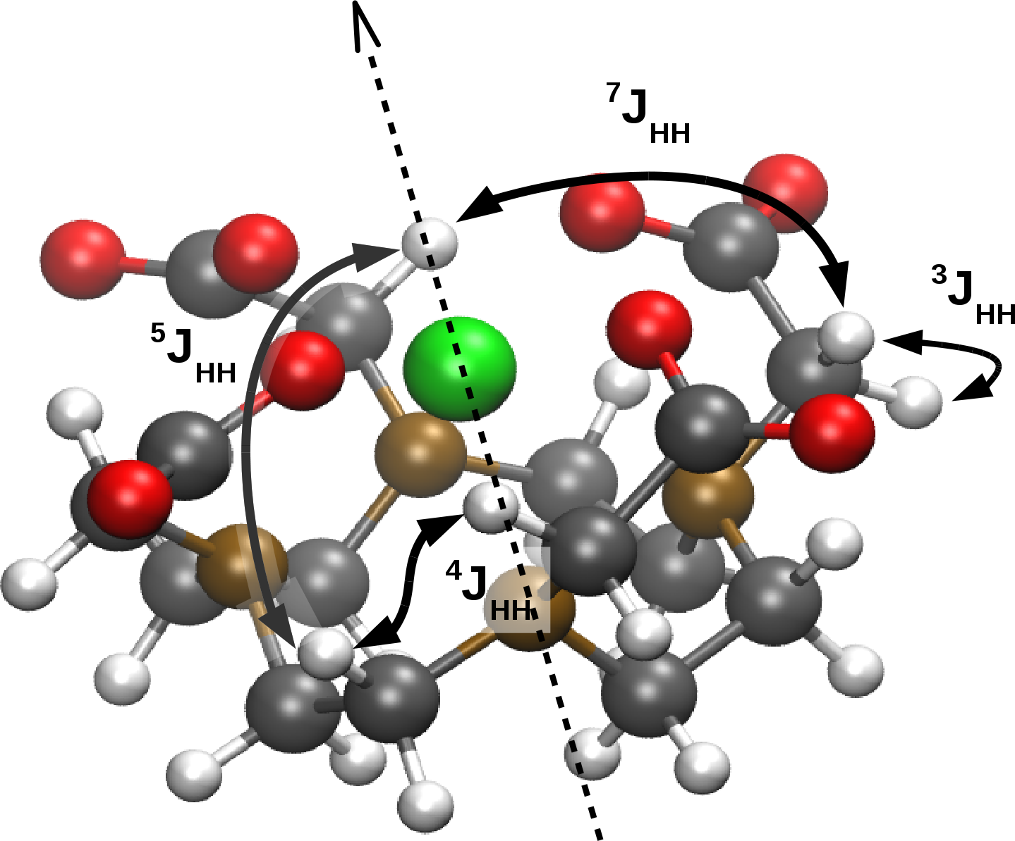
J-enhancement in Gd-DOTA
 | ∆J^{iso}(Hz) | ∆J^{aniso}(Hz)
³J_{HH} | 2.40 | -1.35
⁴J_{HH} | 2.58 | -1.99
⁵J_{HH} | 6.59 | -5.4
⁷J_{HH} | -3.27 | 9.41
Table 2: Enhancement to isotropic and anisotropic J-values for Gd-DOTA.
Fig. 9: Gd-DOTA structure. Oxygen → red. Nitrogen → brown. Other elements as before.

Slide 34
Paramagnetic spin-spin coupling enhancement
Q1) Is J-coupling qualitatively different in systems with unpaired electrons?
Q2) Do we need to account for it when analyzing pNMR spectra?

Slide 35
Paramagnetic spin-spin coupling enhancement
Q1) Is J-coupling qualitatively different in systems with unpaired electrons?
Q2) Do we need to account for it when analyzing pNMR spectra?
A1) Yes, nuclear spins are coupled by the electron spin-density, without explicit dependence on distance.
A2) Probably not at short distances, could be significant at long distances.

